Slide 1
Circuits Workshop
By Nick, Dallas, and Daniel

Slide 2
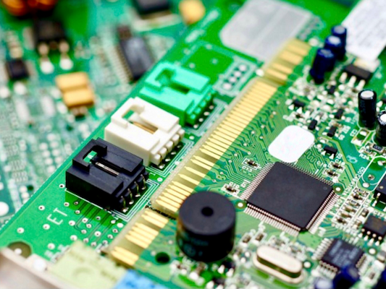
What Are Circuits?
A circuit is a circular flow of electricity that travels out of a power source (battery), goes through a load to do some tasks, and returns to the source.
Circuits are used in many essential fields and objects that power our everyday lives.

Slide 3
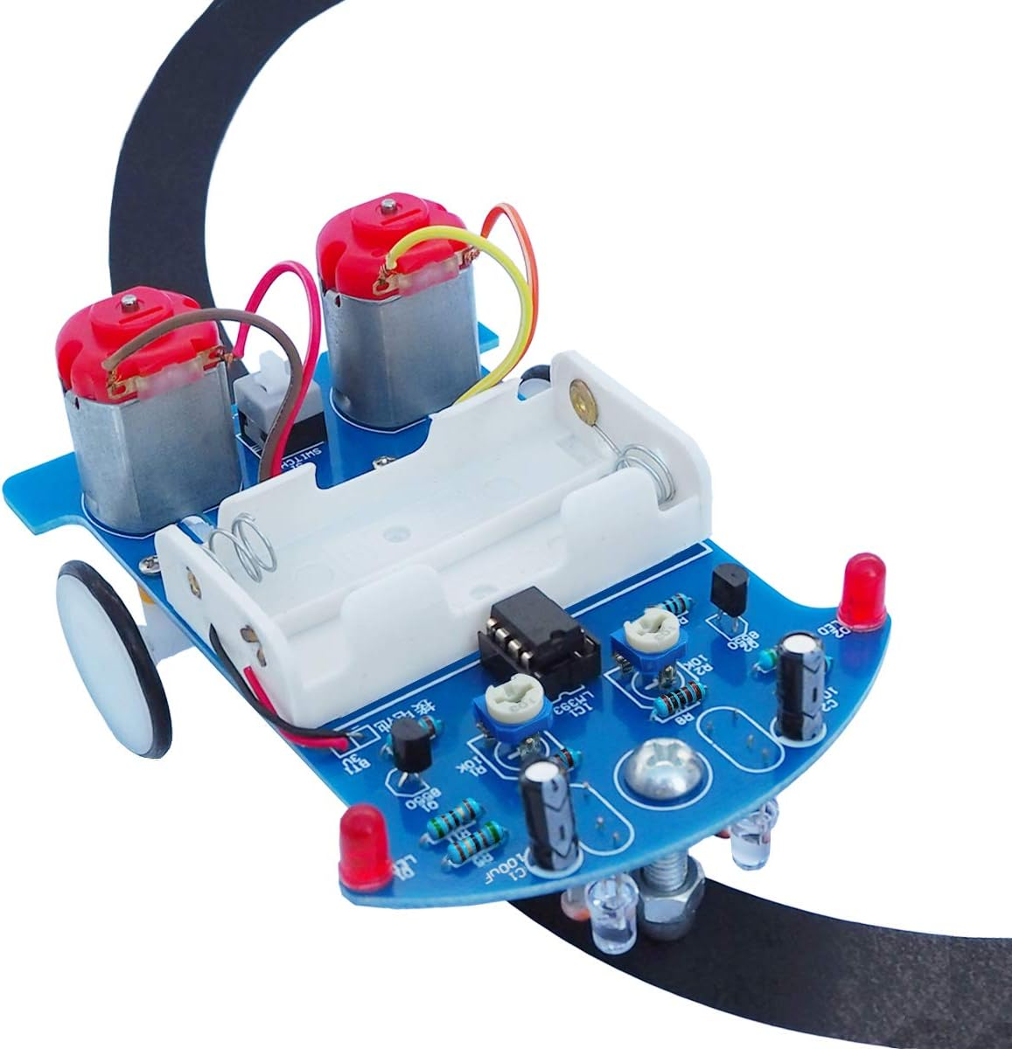
What Will We Be Making?
We will be putting together a mini-car powered by a small circuit.
We will learn about the components of the circuit and how they relate to the car and other things.

Slide 4
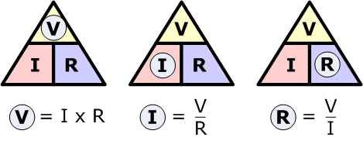
Voltage, Current, and Resistance
- Voltage is the difference in electric potential energy per unit charge.
- The unit for voltage is the volt, symbolized as V.
- Current represents the flow of electrons and indicates the rate at which they move.
- The unit for current is the ampere (amp), symbolized as I.
- You can think of it like water flow: if the water flows quickly, the current is higher; if it flows slowly, the current is lower.
- Resistors are used to provide resistance.
- Resistors limit the flow of current.
- The unit for resistance is the Ohm, symbolized by the Greek letter omega (Ω).
- Use the equation V = IR to calculate voltage. This formula can be rearranged to solve for current or resistance, as shown by the voltage triangle.

Slide 5
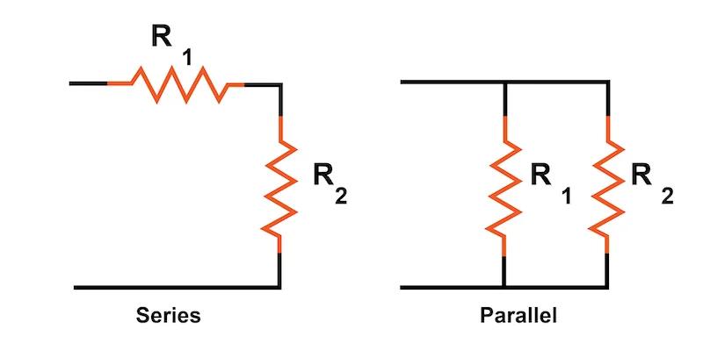
Series v Parallel
Series
In a series circuit, the power runs from component to component, slowly dropping in levels as it goes through the circuit.
Parallel
In a parallel circuit, the power is the same on all components.
All the components are connected across each other.
Notes:
Nick’s slides

Slide 6
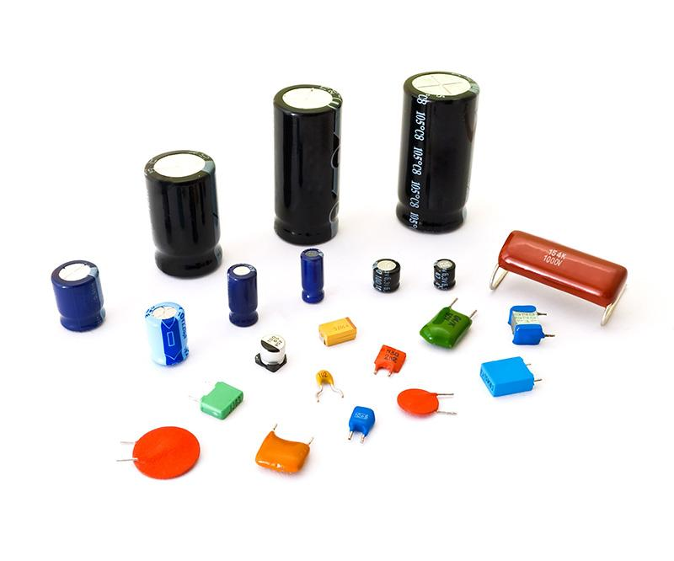
Capacitors
Electronic component with a capacity to store charge
Consists of two conductive plates separated by an insulating layer (dielectric)
Positive charge accumulates on one plate, negative charge on the other
Discharges once it has reached capacity and there is no electrical field (i.e., no more power)
Used for sensing, signal processing, energy storage, and motor starters (charge helps increase torque)

Slide 7
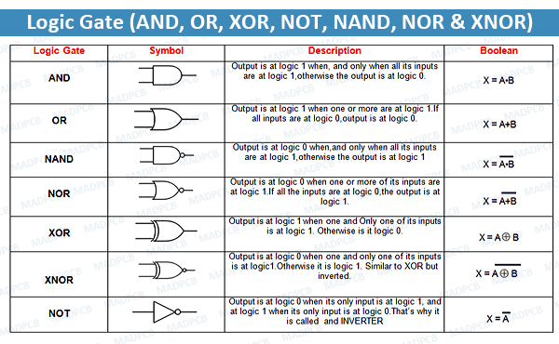
Comparators and Gates
- A comparator in a circuit compares two input voltages and determines which is higher. It outputs either a 0 or a 1.
- A logic gate performs a Boolean logic operation on one or more binary inputs and produces a single binary output.
- There are seven types of basic logic gates, shown in the diagram on the right, but we will focus on three today: AND, OR, and NOT.
- The AND gate outputs 1 only if both inputs are 1.
- For example, if both inputs are 1, the output will be 1.
- If one input is 0 and the other is 1, the output will be 0.
- The OR gate outputs 1 if one or both inputs are 1.
- If both inputs are 0, the output will be 0.
- The NOT gate, which is an inverter, reverses the input.
- If the input is 1, the output will be 0.
- If the input is 0, the output will be 1.

Slide 8
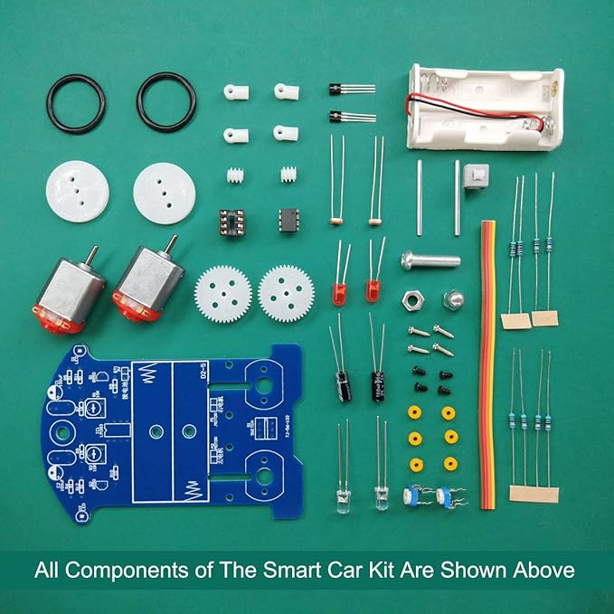
Relating to the Activity ; How does this relate to the Car?
When building the car, you will see how all the components of a device work together while having fun soldering.
In everyday devices, like cellphones and laptops, circuits and other components have become standard and often compact.
This activity demonstrates the simplest form of circuitry.
Notes:
Nick’s slides

Slide 9

Soldering Tutorial

Slide 10
Thanks for Attending!
We hope you enjoy the rest of the hackathon.

